Slide 1
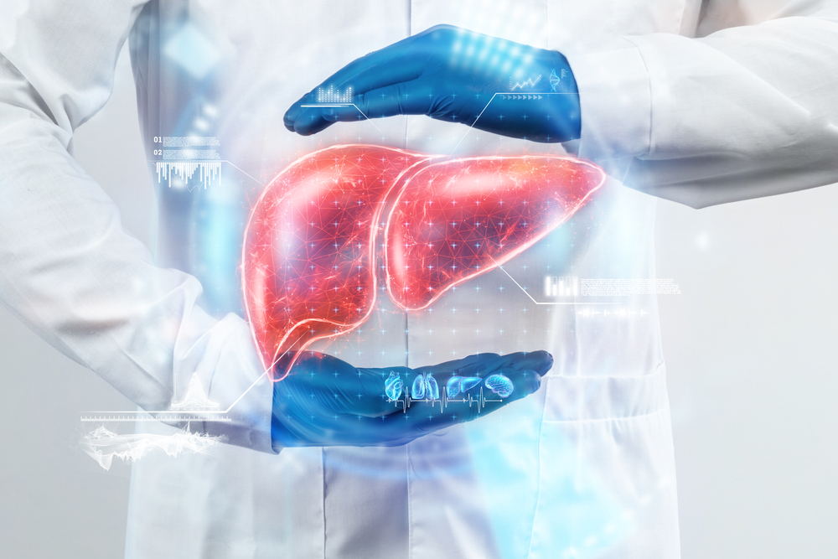
LIVER DISEASE CLASSIFICATION
By :
Siddha Regilla
Subham Vishvkarma
Pranav Ransing
Amit Kumar Singh
Mentored by –
Karthik Muskula sir

Slide 2
INTRODUCTION TO LIVER DISEASE PREDICTION
Liver classification refers to the process of using data-driven models to differentiate between healthy and unhealthy liver conditions, helping with early detection and diagnosis
Importance of Early Diagnosis
Liver diseases—including Hepatitis, Fatty Liver, and Cirrhosis—often progress without noticeable symptoms. Early detection is crucial, as it can improve treatment outcomes, lower healthcare costs, and prevent severe complications like liver failure.
Purpose of the Project
The project aims to develop a machine learning model that classifies liver conditions using patient data. By providing actionable insights, the model will assist healthcare professionals in diagnosing and managing liver diseases more effectively

Slide 3
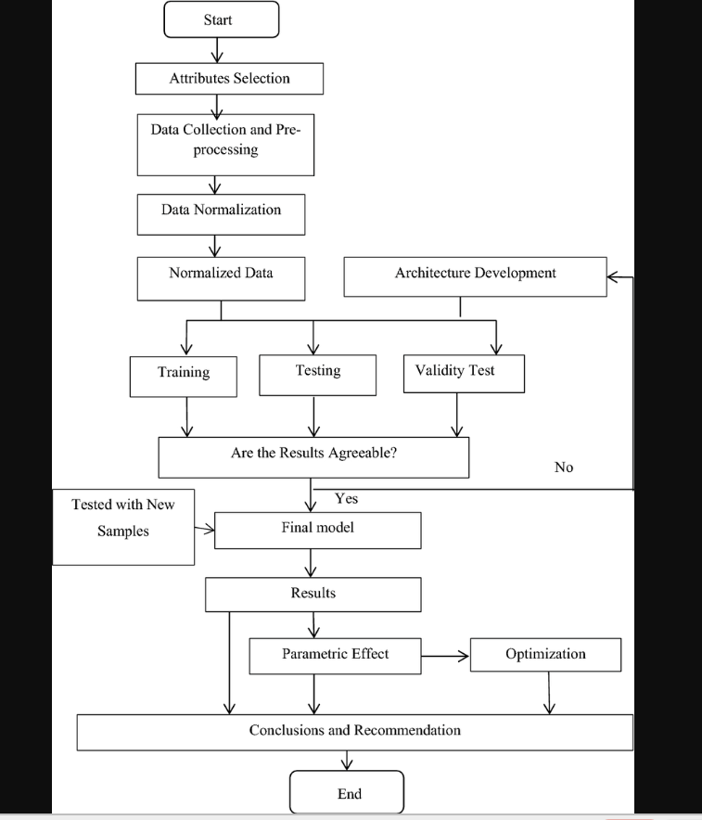
MODEL FLOWCHART

Slide 4
EDA (OVERVIEW)
Dataset Insights:
Features:
Continuous: Albumin, Alkaline Phosphatase, Alanine Aminotransferase, etc.
Categorical: Age Bin, Sex (encoded as 0 and 1).
Data Cleaning:
Handled missing values using mean imputation.
Encoded categorical variables (Sex: 'm' → 0, 'f' → 1).
Key Visualizations:
Univariate Analysis:
Histograms for distribution of Albumin, Bilirubin, etc.
Bivariate Analysis:
Correlation heatmap: Key relationships between features.

Slide 5
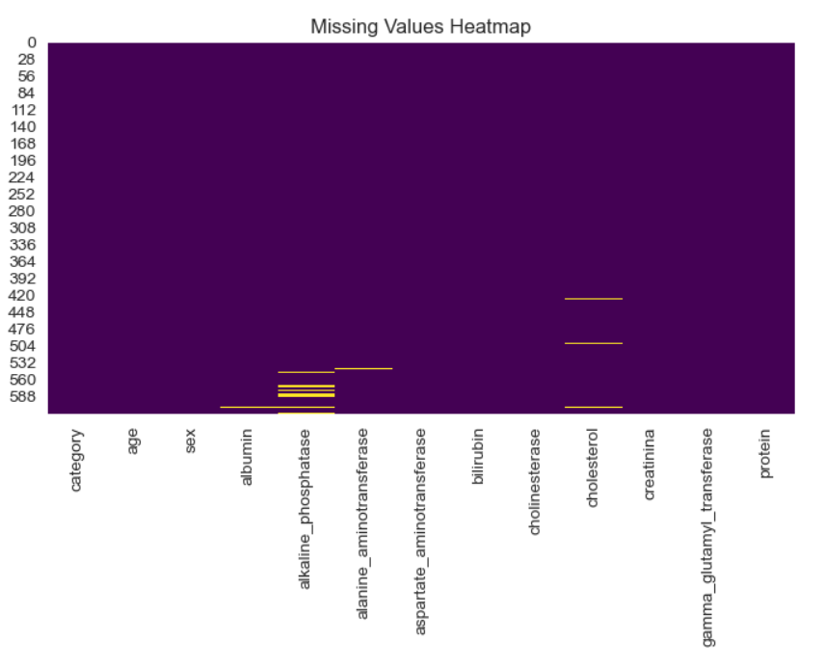
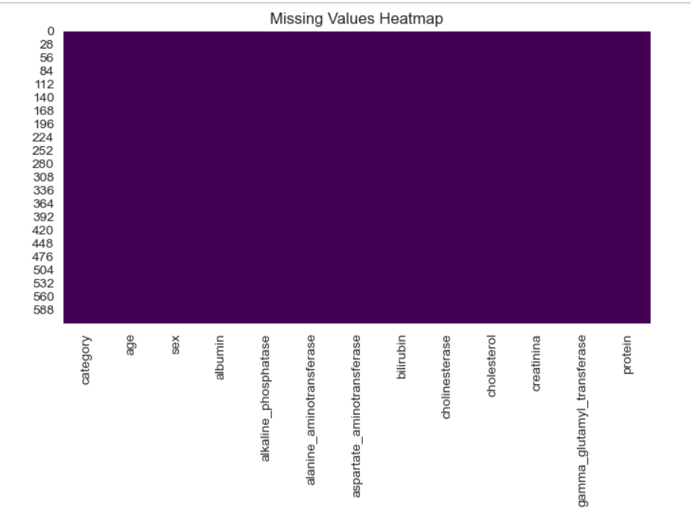
MISSING VALUES BEFORE AND AFTER EDA
BEFORE AFTER

Slide 6
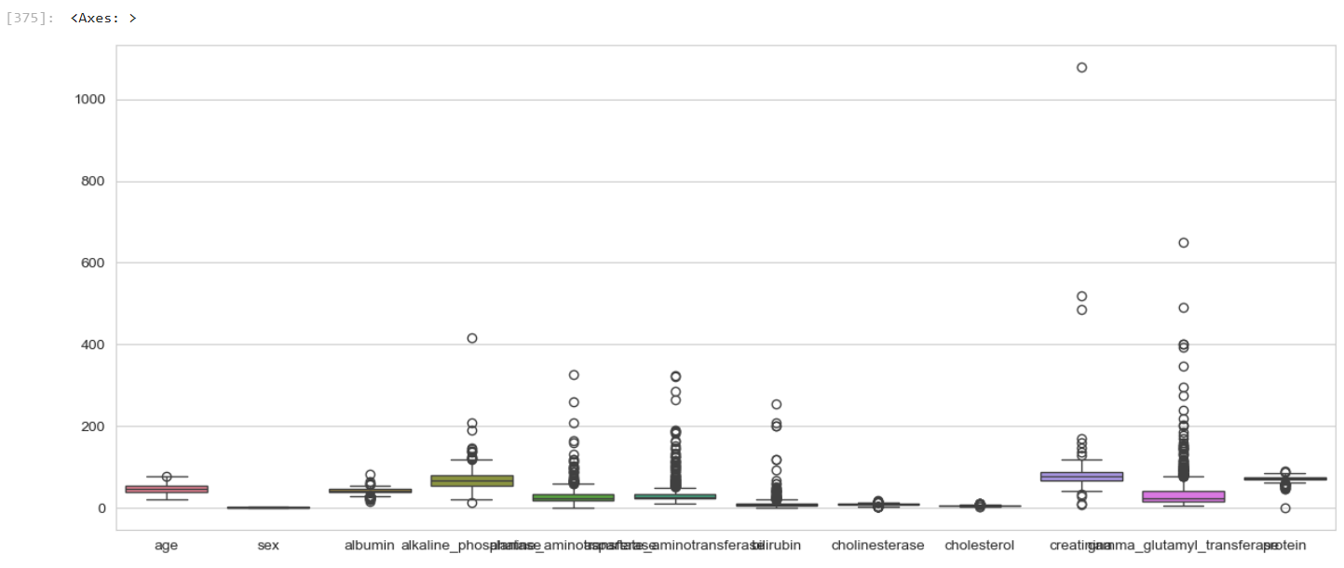
OUTLIERS BEFORE AND AFTER EDA
BEFORE

Slide 7
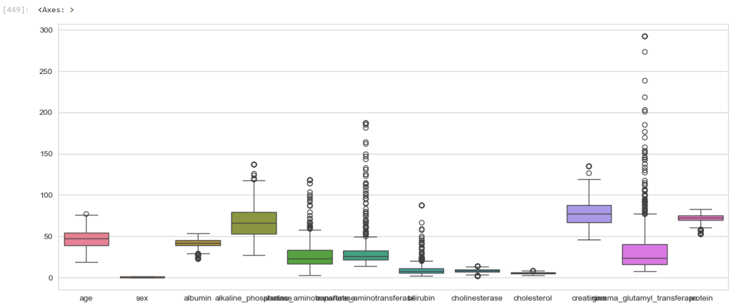
AFTER

Slide 8
Model Building Key Points
Model Selection & Training:
Consider classification algorithms:
KNN
SVM
Random Forest
Gradient Boosting
Train models on training data and validate on a separate set.
Hyperparameter Tuning:
Use Grid Search or Random Search to optimize parameters.
Implement cross-validation for robustness.

Slide 9
Model Evaluation:
Metrics to consider:
Accuracy, Precision, Recall, F1 Score, ROC-AUC.
Visualize performance using confusion matrices.
Compare Models:
Summarize metrics to select the best-performing model.
Consider ensemble methods if needed.
Final Model Selection:
Select the optimal model for deployment and reporting.
Iterate & Improve:
Refine preprocessing, model choice, and tuning for better performance.

Slide 10
MODELS AND THEIR ACCURACY
Neural networks– Accuracy: 0.9674, ROC AUC: 0.8948
xgboost - Accuracy: 0.9593, ROC AUC: 0.9304
Random forest –Accuracy: 0.9430, ROC AUC: 0.9494
Gradient boosting - Accuracy: 0.9430, ROC AUC: 0.9421
SVC - Accuracy: 0.9630, ROC AUC: 0.9713
Knn- Accuracy: 0.9349 , ROC AUC: 0.8750

Slide 11
RESULT
As a result, the Neural networks achieved a high accuracy of 96.7%, demonstrating its effectiveness in classifying liver conditions accurately. This remarkable performance highlights the model's reliability for clinical applications in liver classification.

Slide 12
Deployment of Liver classification project
Deployment of "Predicting Liver Disease" Project in PyCharmOverview: The project utilizes Streamlit for the user interface and Joblib for model serialization. The goal was to create an interactive web app for predicting liver disease
Deployment Steps:Setting Up Environment:Created a virtual environment in PyCharm.Installed required packages: streamlit, joblib, pandas.
Model Serialization:Used Joblib to save the trained model, ensuring it could be loaded efficiently during runtime.Building the Streamlit App:Developed the Streamlit interface for user inputs and displaying results.Integrated model loading and prediction logic.Running the App:Deployed locally using the command streamlit run DiseaseDetection.
Challenges Faced:Dependency Issues:Encountered version conflicts with libraries, requiring careful management of package versions.Model Loading Time:Initial loading of the model was slow, prompting optimizations in the code.User Input Validation:Ensuring robust validation of user inputs was challenging, leading to potential crashes if inputs were malformed.Conclusion:
The deployment of the "Predicting Liver Disease" project in PyCharm was successful, enabling interactive predictions. Addressing dependency management and optimizing model loading improved performance. Overall, the project highlighted the importance of thorough testing and user input validation in creating a reliable application.

Slide 13
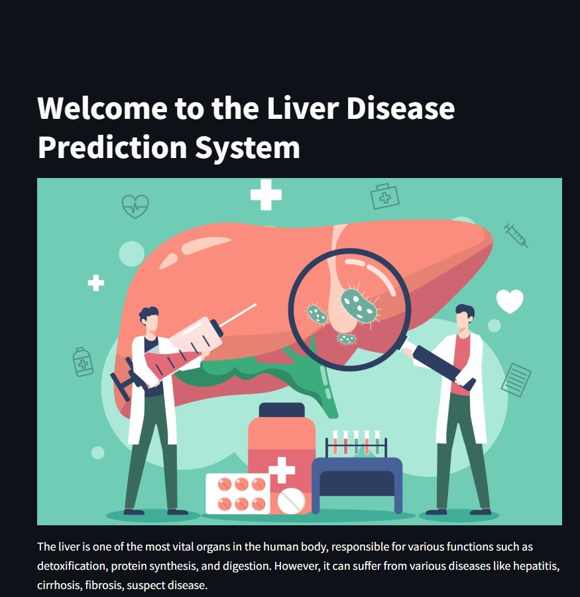
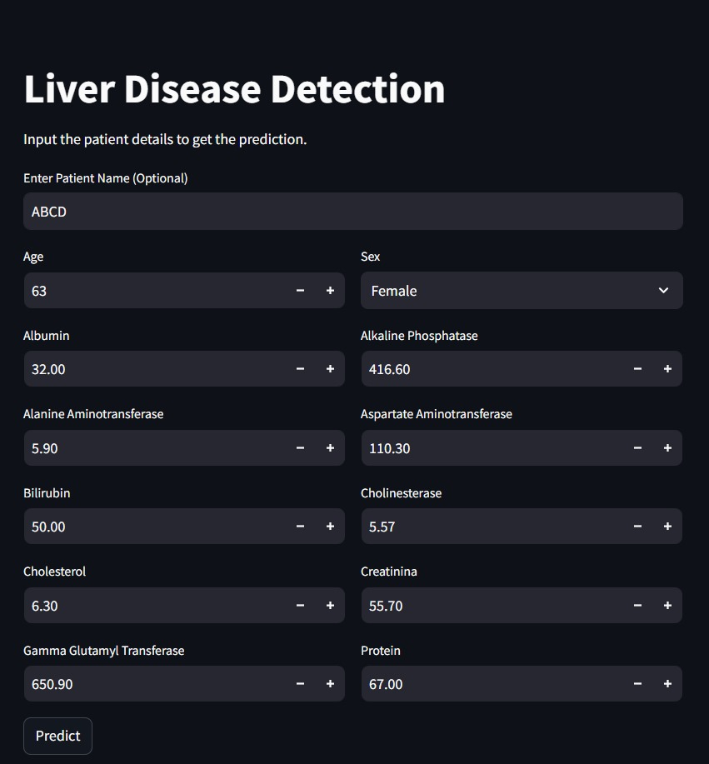
Front Page of deployment
Input page

Slide 14
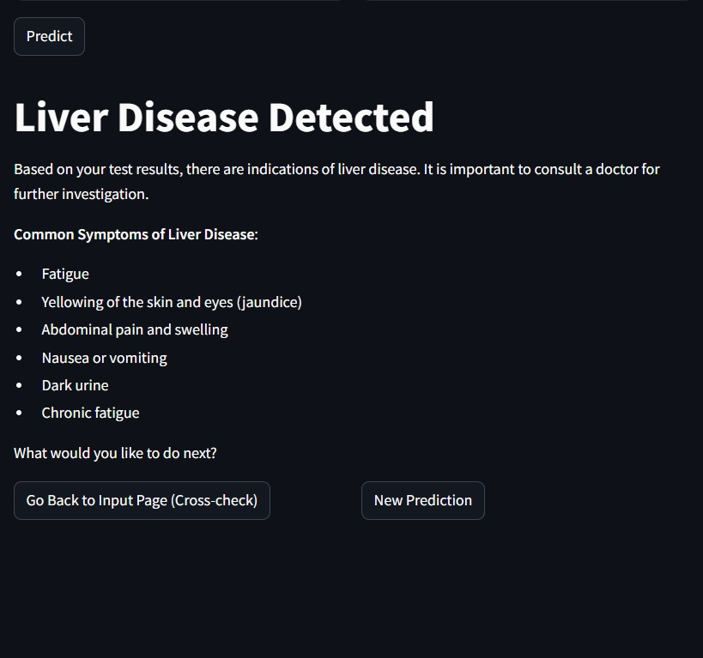
Prediction page 2

Slide 15
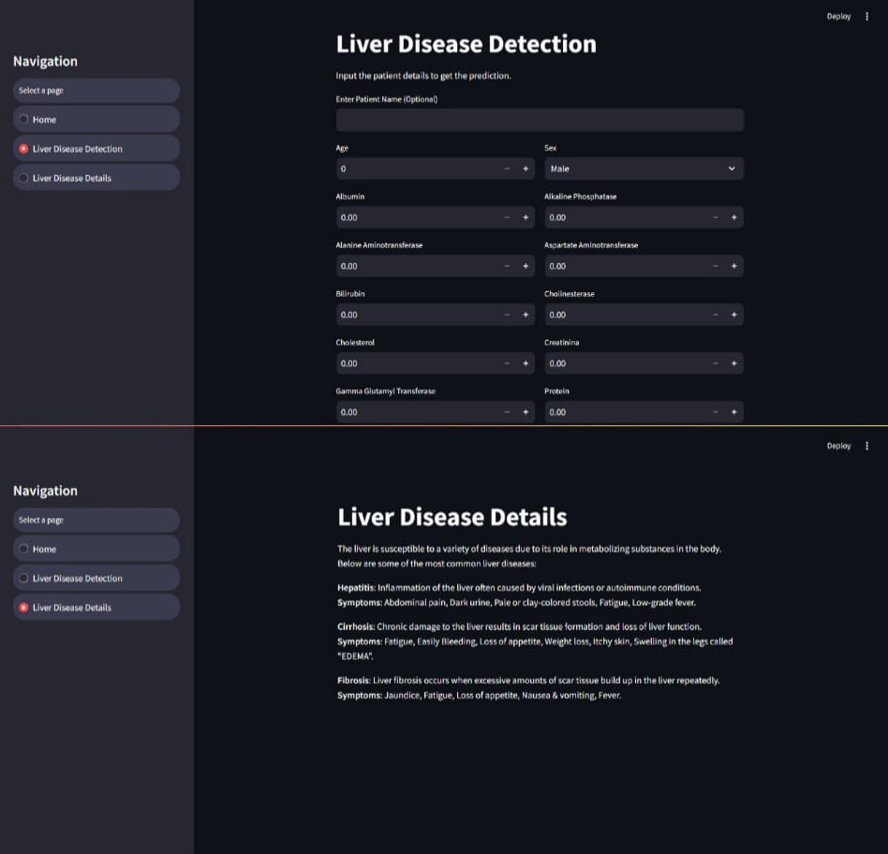
Navigation page

Slide 16
CHALLENGES
Data Quality Issues:
Encountering missing values and inconsistencies in the dataset challenged the initial analysis. However, this prompted the implementation of robust data preprocessing techniques, improving overall data quality and enhancing model reliability.
Model Complexity:
Balancing the complexity of multiple models while ensuring interpretability posed a challenge. This led to thorough model evaluation and hyperparameter tuning, ultimately resulting in a more accurate and well-optimized predictive model.
Feature Selection:
Identifying the most relevant features from a large dataset was challenging due to redundancy and multicollinearity. This led to the development of efficient feature selection techniques, which not only streamlined the model but also improved interpretability and performance.
Overfitting Risk:
There was a risk of overfitting due to the complexity of certain models. This challenge encouraged the use of cross-validation techniques, which enhanced the generalization capability of the models and ensured they performed well on unseen data.
Model Comparison:
Comparing multiple algorithms (like SVM, Random Forest, etc.) and selecting the best-performing model presented complexity. This challenge fostered a thorough understanding of each algorithm's strengths and weaknesses, leading to an informed choice that maximized the model’s predictive power.

Slide 17
Advantages of the Liver Disease Prediction
Predictive Accuracy:
The project achieved high accuracy rates with multiple machine learning models, enabling reliable predictions of liver disease outcomes.
Data-Driven Insights:
The analysis of biochemical parameters provided valuable insights into key indicators of liver health, helping clinicians make informed decisions.
Robust Methodology:
The use of various algorithms (SVM, KNN, Gradient Boosting, Random Forest) ensured comprehensive model evaluation, allowing for comparison and selection of the best-performing model.
Hyperparameter Tuning:
Implementing hyperparameter tuning improved model performance and fine-tuned the classifiers for optimal accuracy, enhancing their predictive capabilities.
Thorough Data Preprocessing:
Rigorous data preprocessing steps, including handling missing values and feature scaling, ensured the quality and consistency of the input data, leading to better model performance.

Slide 18
Generalizability:
Employing cross-validation techniques demonstrated the models' ability to generalize well to unseen data, increasing confidence in their practical applications.
Healthcare Relevance:
By focusing on liver disease classification, the project addresses a critical area in healthcare, contributing to early detection and better patient management.
Potential for Future Research:
The project lays a strong foundation for future research and advancements in predictive modeling for liver health, with opportunities for incorporating additional data sources and features.
User-Friendly Interface:
If applicable, the potential for developing a user-friendly interface for healthcare professionals could facilitate easy access to predictive analytics in clinical settings.
Interdisciplinary Collaboration:
The project fosters collaboration between data science and medical fields, highlighting the growing importance of interdisciplinary approaches in healthcare

Slide 19
Conclusion -
As per our analysis and domain expert consultation we found that the data provided is not large enough to accurately predict the specific disease. To increase the accuracy of prediction we choose to predict in binary format that is whether a patient will have liver disease or not. If liver disease is detected, the patient is recommended to consult a doctor for further investigations,

Slide 20
THANK YOU

